Slide 1
Heart Disease Prediction Using Artificial Intelligence Methods
Dana Nedal Ghazal
Computer Engineering Department

Slide 2
INTRODUCTION
Heart disease is considered a life-threatening disease, and a great deal of attention for this disease has been received in medical research.
Diagnosing heart disease is a challenging task, and it is difficult to identify heart disease due to several contributing risk factors such as diabetes, high blood pressure, high cholesterol, abnormal pulse rate and other factors.
Machine learning has proven to be effective in helping to make decisions and predictions from the large amount of data produced by the healthcare industry.
Recently, machine learning algorithms such as K-Nearest Neighbor )KNN( and Decision Trees (DT) have become very useful for accurately predicting the presence or absence of heart-related diseases.

Slide 3
Motivation
The main motivation for doing this project is to predict future heart disease by analyzing patient data that classifies whether or not they have heart disease using a machine learning algorithm.
The work of this project aims to define the best classification algorithm for determining the probability of developing heart disease in a patient. It also aims to increase the accuracy with which heart disease risk can be predicted.
This work was justified by conducting a comparative study and analysis using five classification algorithms namely, Logistic Regression, SVM, Random Forest, K-Nearest Neighbors and Decision Tree.

Slide 4
Problem Definition
There are tools available that can predict heart disease but they are either too expensive or ineffective to calculate the chance of heart disease in humans.
Early detection of heart disease can reduce mortality and general complications. However, it is not possible to monitor patients every day accurately in all cases.
Since we have a large amount of data in today's world, we can use this data to predict whether or not a patient has heart disease using different machine learning algorithms.

Slide 5
Literature Review
In this project, we performed computer simulation on one dataset. The cardiology dataset is available on Kaggle.
Which dates back to 1988 and consisted of four databases: Cleveland, Hungary, Switzerland, and Long Beach V., and applied algorithms to them to get the results.
Different researchers have contributed for the development of this field. Predication of heart disease based on machine learning algorithm is always curious case for researchers recently there is a wave of papers and research material on this area.
Previous studies were less accurate, so we focused in this project to enhance accuracy which is critical parameter in the medical field.

Slide 6
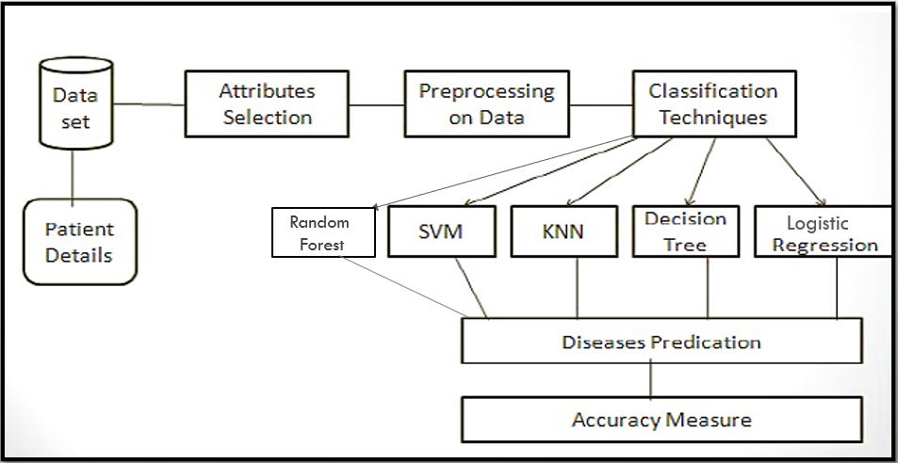
Proposed model

Slide 7
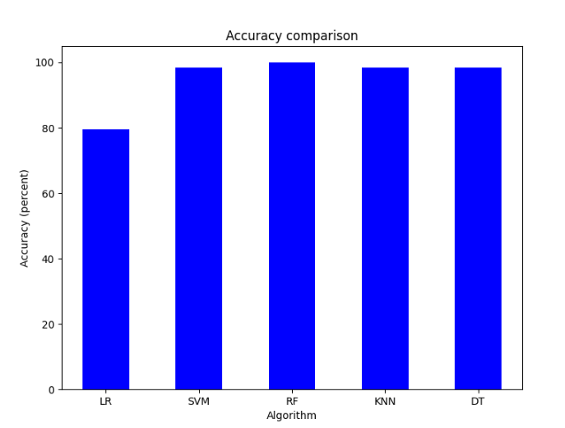
RESULT
After the experiments, we found that Random Forest gives us the highest accuracy of 100%, followed by 98.53% for SVM, KNN and Decision Tree, these three algorithms give us the same accuracy. Finally, the algorithm that gives us the least accuracy is a logistic regression of 79.51%, as shown in Figure Comparing the results for the different algorithms.

Slide 8
CONCLUSION
Heart disease prediction is challenging and very important in medical field ,application of promising technology such as machine learning to the initial prediction of heart disease will have a profound impact on society.
In this project, 5 different machine learning algorithms used to measure performance are SVM, Decision Tree, Random Forest, K-Nearest Neighbor, and Logistic Regression applied to the dataset.
The Random Forest algorithm proved to be quite accurate in the prediction of heart disease gives us the highest test accuracy, which is 100%.
In the future, machine learning approach will be used for better analysis of heart disease and for early disease prediction so that death rate can be reduced through disease awareness.

